Slide 1

Project Audrey
Making audio stories in isolation

Slide 2
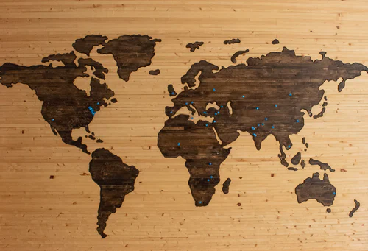
Premise
Challenge:
Can we create an audio story when the contributors are distributed around the world.
Benefits:
Contributors can be isolated.
Larger selection of contributors.
Cheaper

Slide 3

Stage 1: Process
Choose a script:
Find a small script that tells a story with at least 2 characters.
It needs to be big enough to gain experience but not to big to be challenging.
Story should be conversation driven to be easy to adapt.
Rewrite script:
Needs to be purely audio. No scenes or actions. Maybe introduce a narrator. If necessary.
Baseline the audio:
Create a first cut audio for each line. Possibly use Text to Speech.
Actors update audio:
Allow actors to interact with each line updating with their own version. Expect multiple cuts.
Post Processing:
Arrange the audio to a final track with sound effects

Slide 4
Stage 1: Interaction
Central Repository:
The core interaction will be over a collection of recordings that correlate to lines or segments of the script. A central website would be great, but initially we will use dropbox for files and a spreadsheet to co-ordinate.
Actors need to be able to update their lines and listen to supporting lines.
Directors need to hear the progress, give direction and select the best versions.
Audio engineers need access to files to arrange the final product.
# | Part | Line | Version
1 | Lisa | You’re very lucky to have Mom. | 1
2 | Homer | That’s your advice? Go to bed! | 3
File: 1_0
File: 1_1
File: 2_0
File: 2_1
File: 2_2
File: 2_3
Iterations:
It’s expected getting the audio will take 3 or more recordings. The actors are not expected to deliver on the first run, they will need collaboration with the supporting parts which will be refined in each iteration.
Baseline
Rough
Close
Refined

Slide 5

Stage 1: Roles
Mandatory:
Co-Ordinator
Script Writer
Voice Actors (at least 2)
Sound Engineer
Optional:
Director
Story Writer
Sound Effects
Music
Graphics
Marketing

Slide 6
The Future
Stage 2:
Full Script. Something that is easily sourced but can be marketed. Eg. Fan fiction.
Full team.
Attempt distribution. Learn from experience.
Stage 3:
Commercialisation

